Slide 1
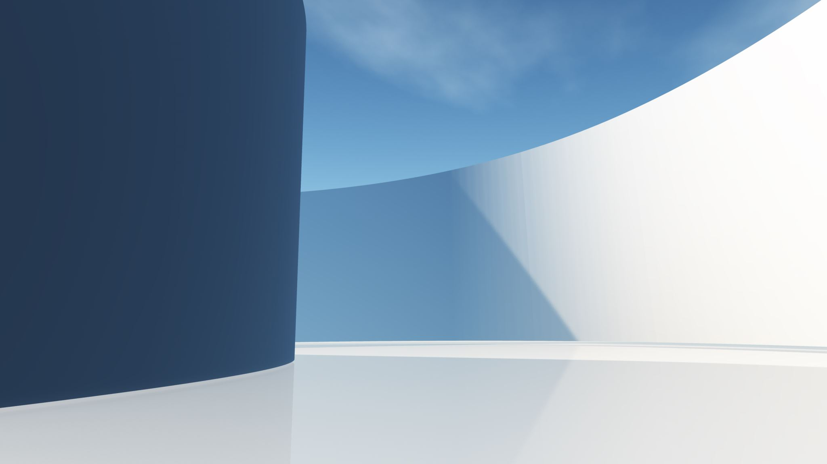
Healthy Behavior Challenge
CSCE 606: Software Engineering, Spring 2024
Client: Prof. S. Niki Ritchey
Group: Fizza Ali, Francis Bui, Michael Chiu, Mackenzie Hamlett, Jakob Kirby, Chenxin Li, and Tolga Yildiz

Slide 2
Table of Contents
1. Our Goal
2. Design
3. Challenges
4. Learnings
5. Improvements
6. Demo

Slide 3

Our Goal
Connect Trainers with Trainees.
Allow for personalized plans and feedback.
Motivate individuals to lead healthier lives.
Gamifying healthy living

Slide 4
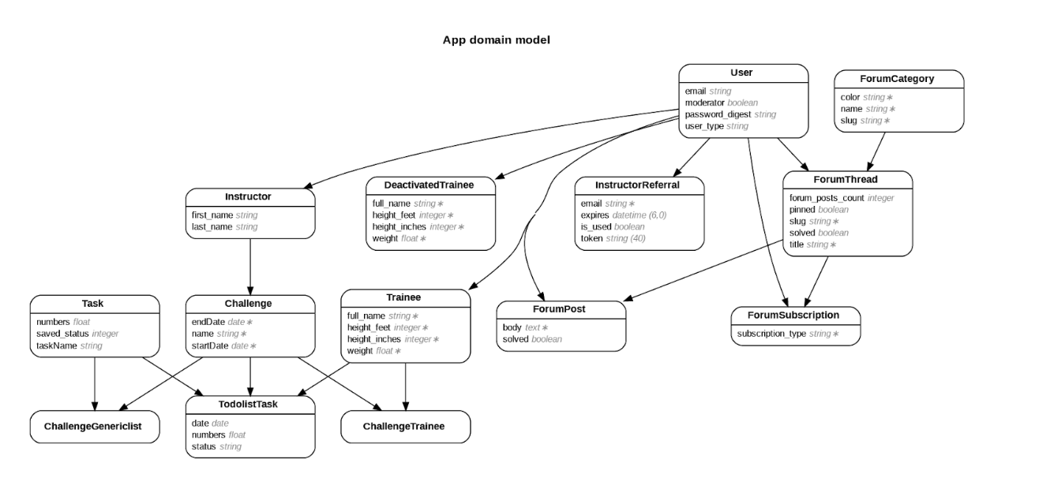
Design

Slide 5
Challenges
Initial usage and getting used to the docker environment
Testing, code coverage, and code quality
TDD and BDD were new for most, and adjustments were needed

Slide 6
Learnings
Practiced Agile and incorporated client feedback into a working prototype.
Learned and practiced TDD and BDD.
The effectiveness of pair programming.
Pull requests serve as initial code reviews.

Slide 7
Improvements
The discussion board is fairly new. Some functionality is missing, and the UI is not great. Limited time.
Like system for discussion board.
Some small bugs.
Coverage and code quality.

Slide 8
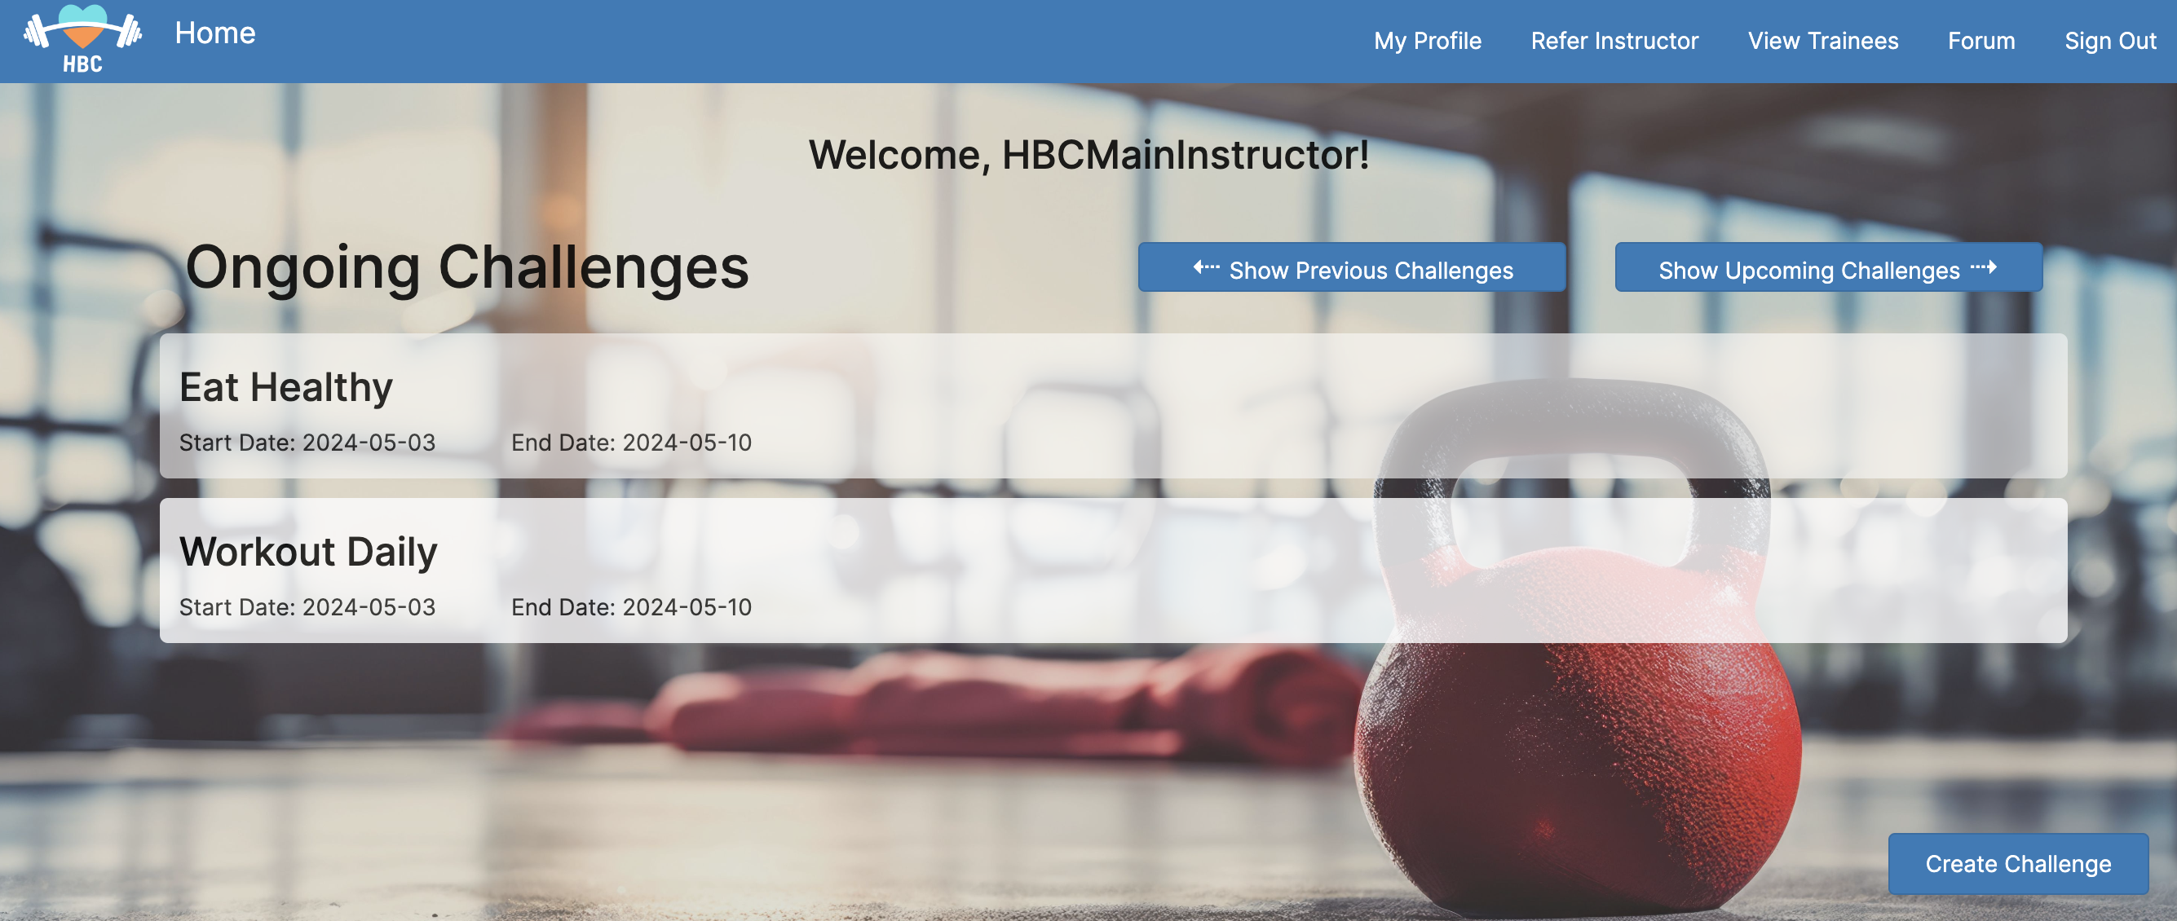
Demo

Slide 9
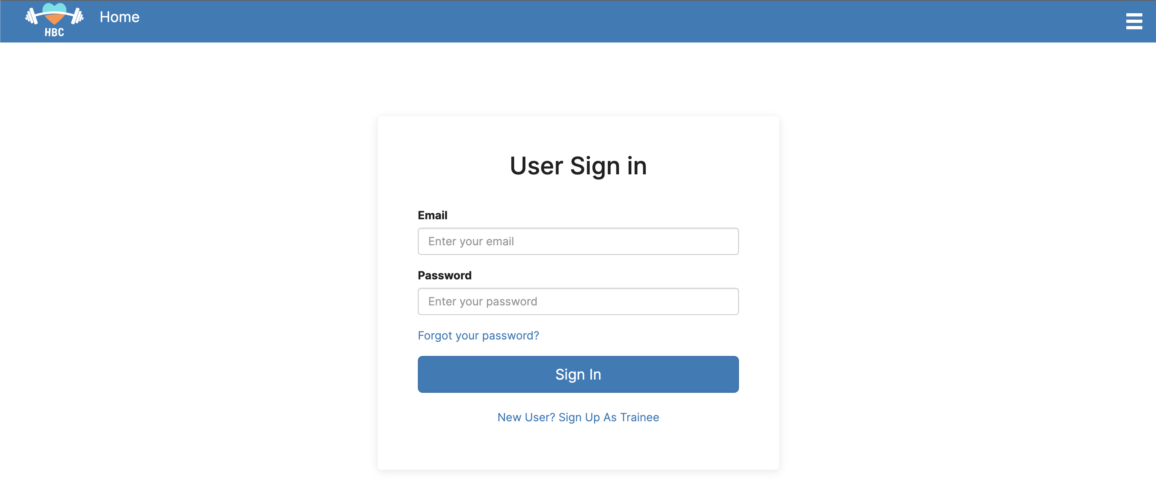
Authentication & Authorization

